Slide 1
Using git/GitHub @ NYC
Claire Boyd
Data Scientist
NYC Department of Finance, Property Modeling & Valuation
boydclaire@finance.nyc.gov

Slide 2


A little about me
Native New Yorker
Researcher at Urban Institute, where I studied equity in philanthropic and federal grant making
Master’s in Computer Science and Public Policy from University of Chicago
Now a Data Scientist at DOF, where I am excited about using and building open-source tools to enhance the work we do for the City of New York

Slide 3
Imagine this.

Slide 4
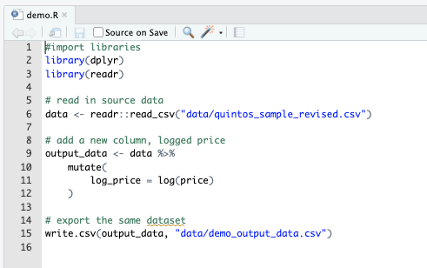
My coworker Ethan and I are tasked to work on a project demo.R. The goal is to add a few more columns to an existing csv (logged estimate, price-estimate).
In the current ecosystem:
How could I work on this task so that my work was version controlled (saved regularly and sequentially)?
How could I collaborate with Ethan on this in real time?
How could we combine our work when it was finished, assuming someone else might want to repeat this process another time?
Where would we store the finished product so that our team knew it was the final version and future data analysts might be able to replicate our work easily?

Slide 5
My coworker Ethan and I are tasked to work on a project demo.R. The goal is to add a few more columns to an existing csv (logged estimate, price-estimate).
In the current ecosystem:
How could I work on this task so that my work was version controlled (saved regularly and sequentially)?
How could I collaborate with Ethan on this in real time?
How could we combine our work when it was finished, assuming someone else might want to repeat this process another time?
Where would we store the finished product so that our team knew it was the final version and future data analysts might be able to replicate our work easily?
Current system | Problems or potential risks
Save different named versions of the same script
Work on different scripts and talk to each other
Copy and paste
Agency-Specific Secure Network Drive

Slide 6
My coworker Ethan and I are tasked to work on a project demo.R. The goal is to add a few more columns to an existing csv (logged estimate, price-estimate).
In the current ecosystem:
How could I work on this task so that my work was version controlled (saved regularly and sequentially)?
How could I collaborate with Ethan on this in real time?
How could we combine our work when it was finished, assuming someone else might want to repeat this process another time?
Where would we store the finished product so that our team knew it was the final version and future data analysts might be able to replicate our work easily?
Current system | Problems or potential risks
Save different named versions of the same script | Which version is the most up to date? How do we revert changes of scripts if we make a mistake?
Work on different scripts and talk to each other | Relies on really good communication to work seamlessly Repetitive work – could do the same portion of the project without realizing it
Copy and paste | Different changes to the same code – how to reconcile? Potential for repetitive code and take additional time to make sure it can run seamlessly
Agency-Specific Secure Network Drive | Should we have a new 2025 folder? Where should it live in the G:/ Drive? Would a new hire easily know where to look for this information?

Slide 7


Enter & .

Slide 8
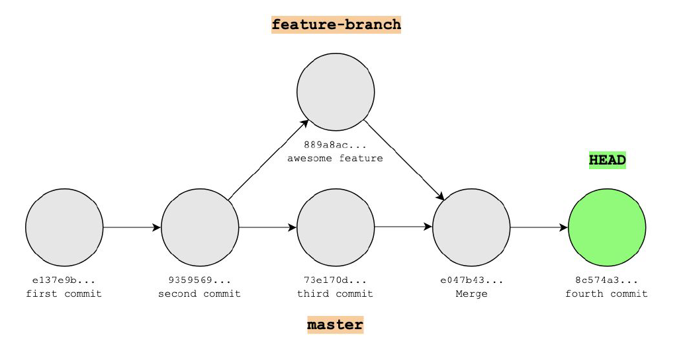
git
git is like Word’s Version History for code.
It is a version control system that keeps track of all changes made in a folder (repository/repo)
A historical backup of “snapshots” of your work
Think of it as a “Save As” version
git (on it’s own) only keeps track of work on your local machine
git saves a stream of snapshots (called commits)

Slide 9
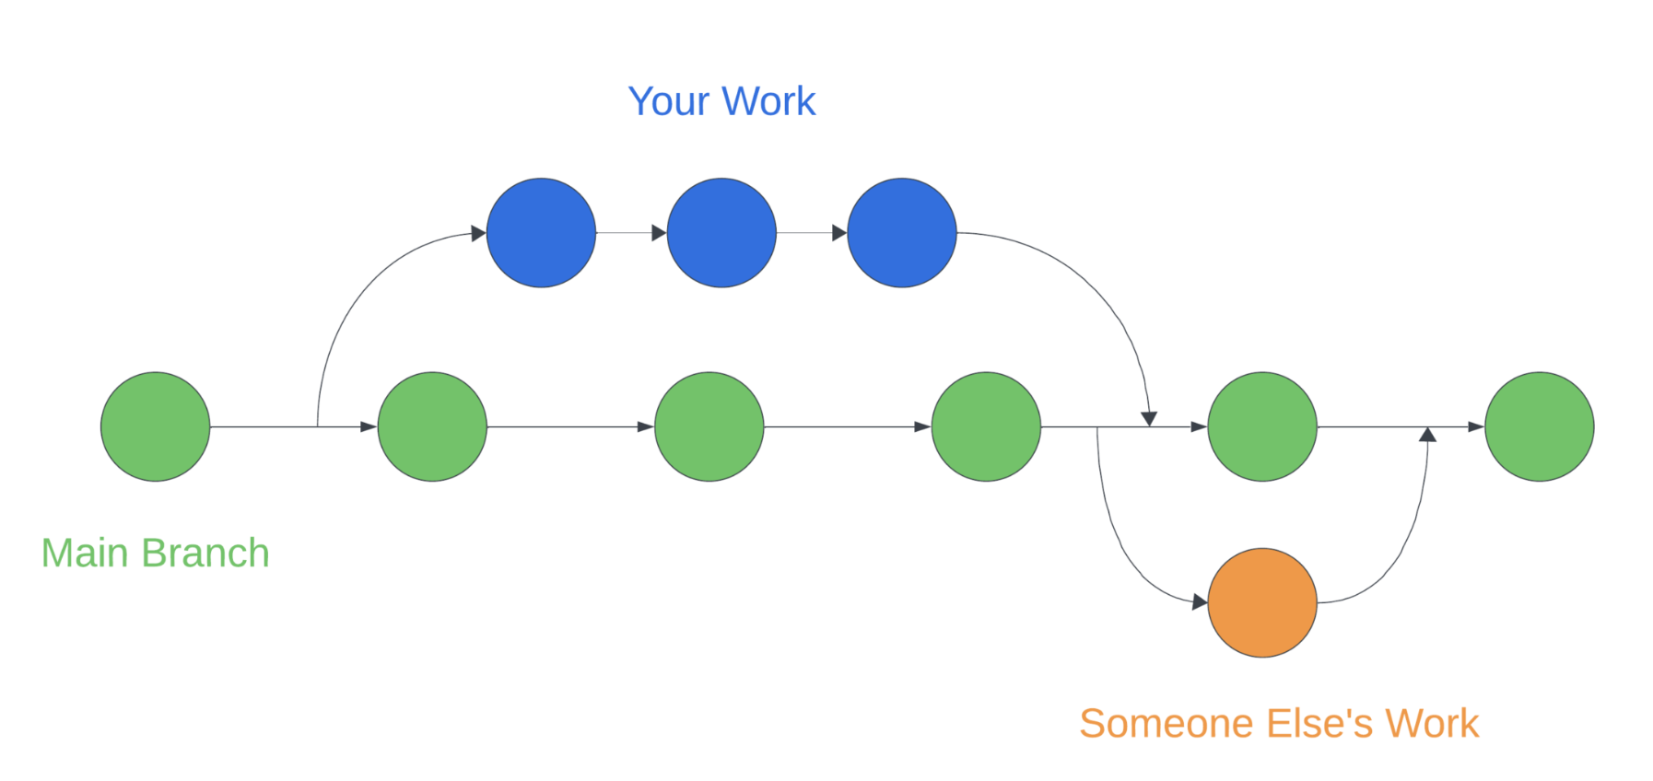
GitHub
Working alone
When you use git/GitHub together, it is like GoogleDocs for code.
GitHub is a website that hosts repositories (folders) under version control by git.
It is the remote (cloud) storage for repositories (folders) that allows us to work together on the same material.
It allows for team development
Different versions of the project (these “snapshots”) can be merged together to create one final version
Allows for simultaneous work
Collaborating with others

Slide 10
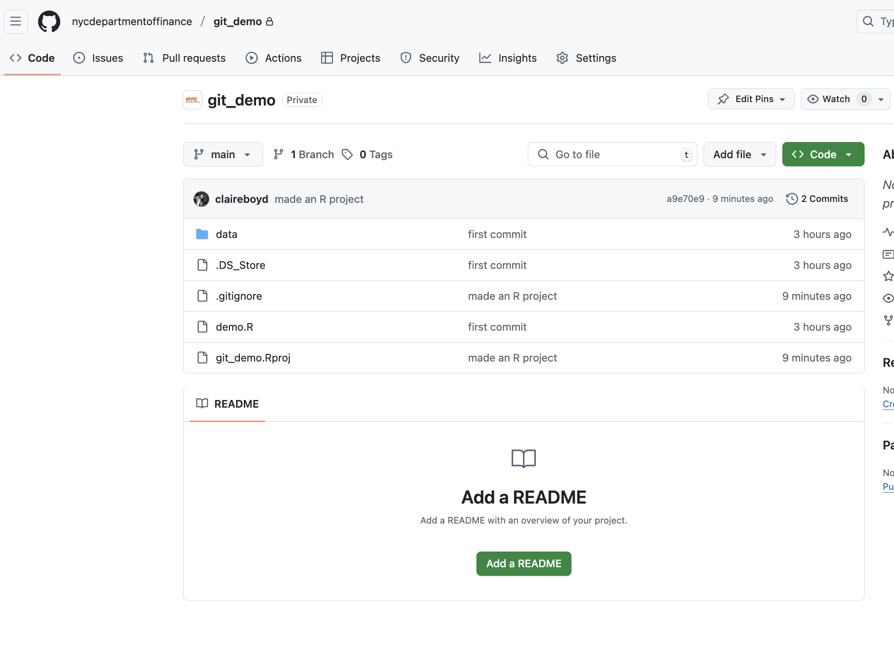
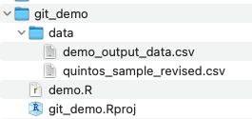
GitHub
GitHub is a website that hosts repositories (folders) under version control by git. It is the remote (cloud) storage for repositories (folders) that allows us to work together on the same material.
Local Machine
git
git is a version control system (a mini programming language) that keeps track of all changes made in a folder (repository/repo)

Slide 11

Using GitHub @

Slide 12
If you use git/GitHub, you might already use it….
For code inspiration: Finding code (in a public repository or folder) that looks similar to what you want to do
To download and review documentation for open-source packages: guides for how to download a package and/or examples of how it works so that you can use it in your own code
To collaborate with other programmers on your team on a data analysis, data science or data engineering task
To build your own package to make common tasks within your team easy to replicate and standardize
….{many more examples…}

Slide 13
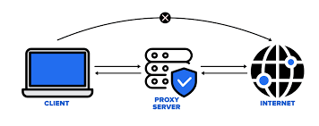
Why might you not already use git/GitHub?
If you use a city machine, it is likely that your internet connection is configured to operate through a proxy server for additional security.
Your browser and other core applications are already configured to reach the internet using the proxy server. Git (and IDEs like RStudio and VSCode) is not automatically configured with these settings, so if you have tried to use it and gotten a HTTP Connection error this might have been why.
There’s a solution! We need to manually configure the settings to allow these applications to successfully access the internet.

Slide 14
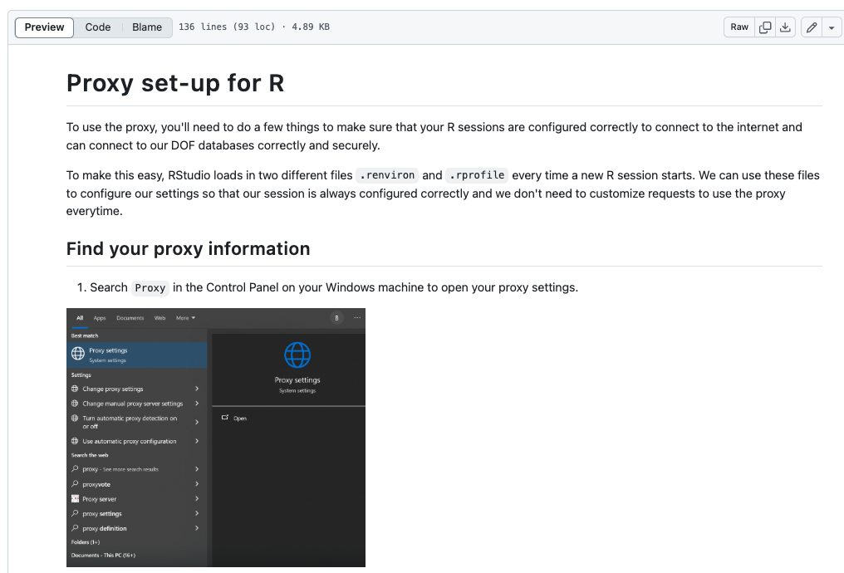
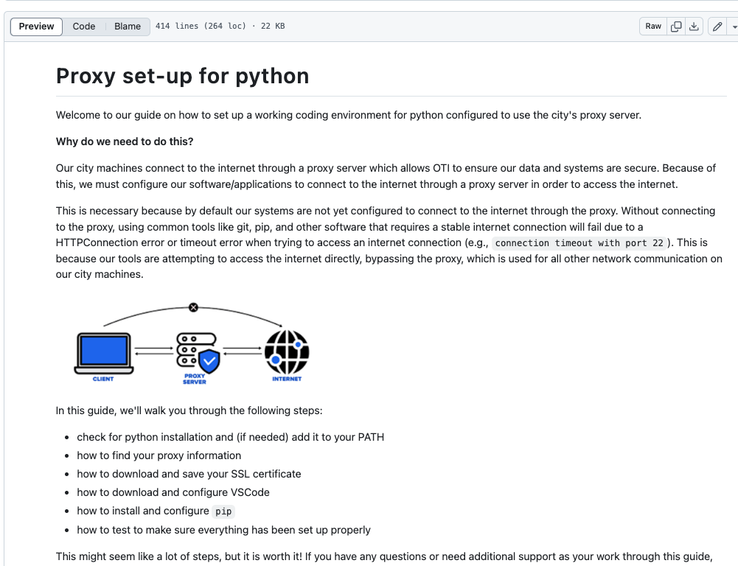
Proxy server set-up
RStudio (R users)
VSCode (python users)
https://github.com/nycdepartmentoffinance/onboarding/blob/main/proxy_R.md
https://github.com/nycdepartmentoffinance/onboarding/blob/main/proxy_python.md

Slide 15
Let’s try it.
Notes:
Share link to markdown file: https://github.com/nycdepartmentoffinance/onboarding/blob/main/github.md

Slide 16
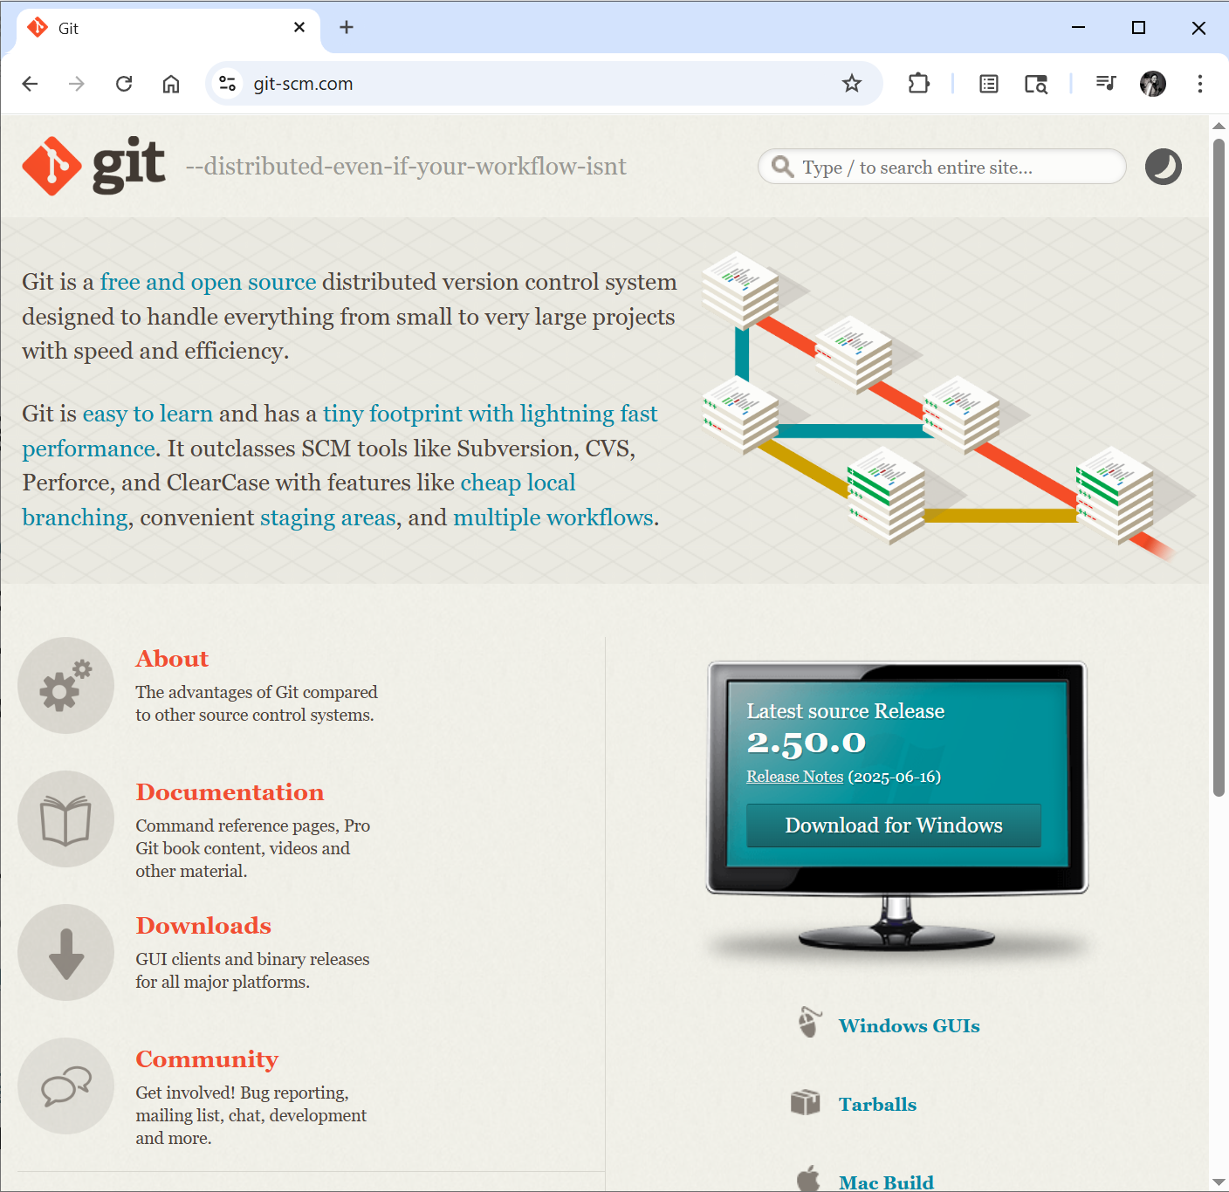
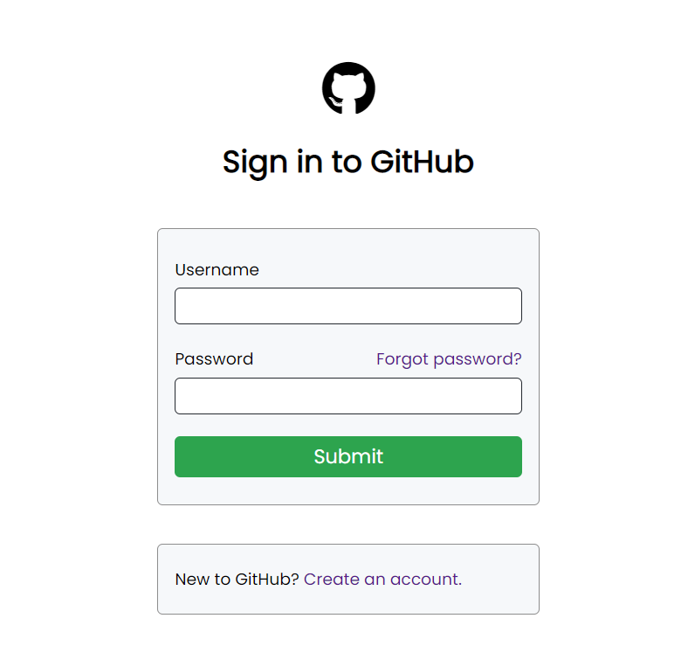
git/GitHub initial set-up
Install git (https://git-scm.com/) on your local machine
Create a free GitHub account (with your work email): https://github.com/

Slide 17
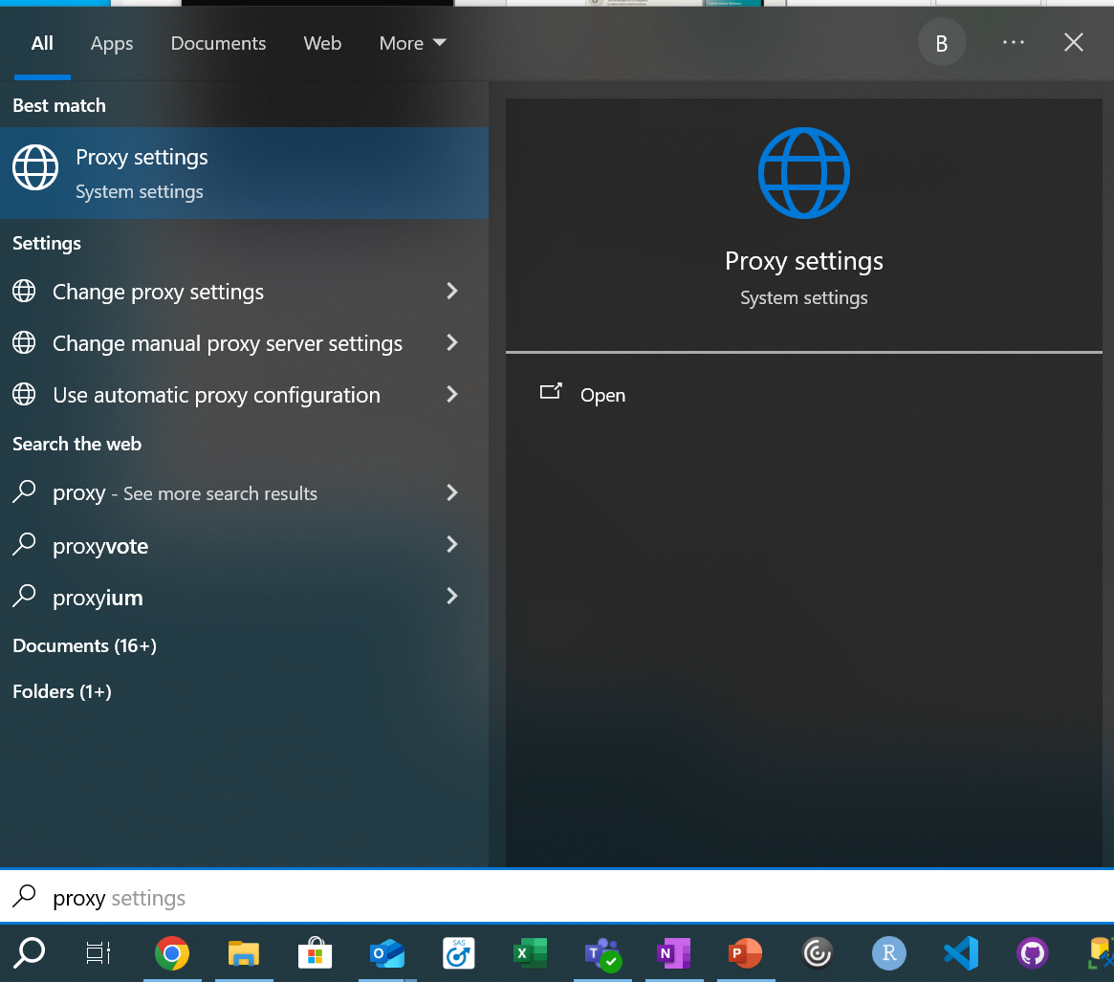
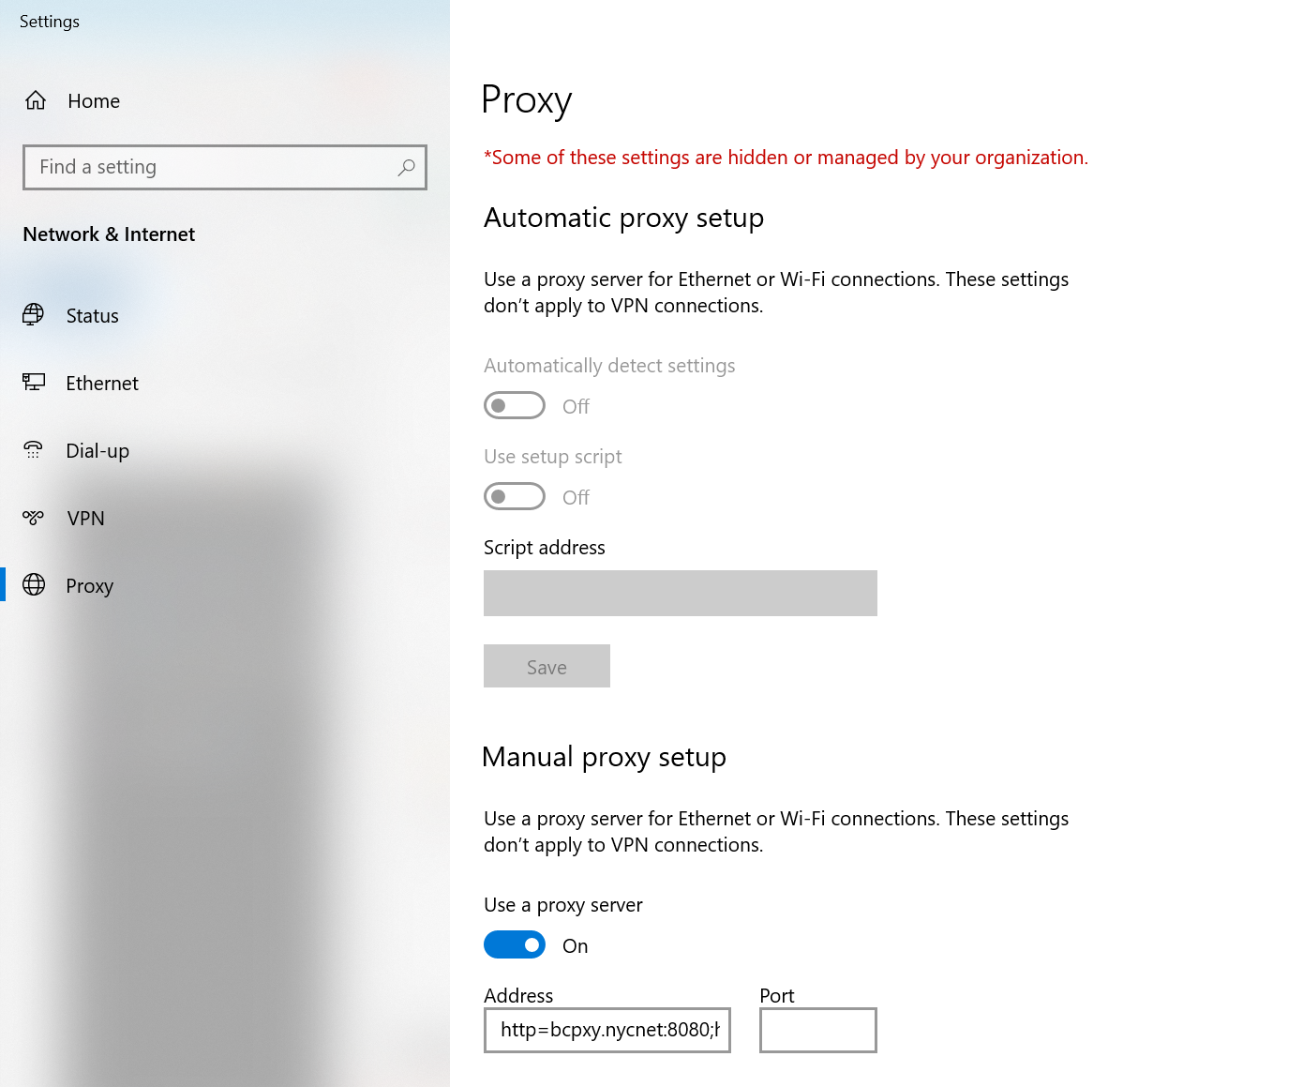
How do you configure git to connect through the proxy?
Step 1: Find proxy hostname // port

Slide 18
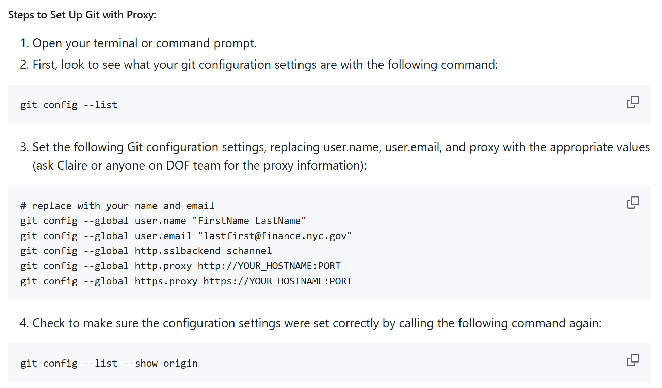
How do you configure git to connect through the proxy?
Step 2: Share this information with git.

Slide 19
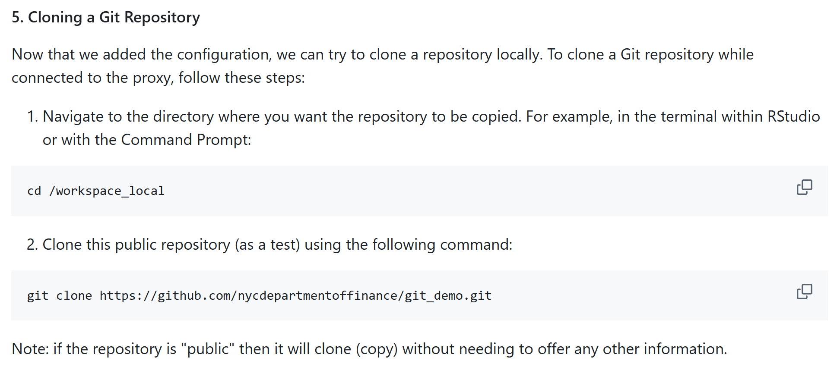
How do you configure git to connect through the proxy?
Step 3: Try cloning (copying) a remote repository from GitHub

Slide 20
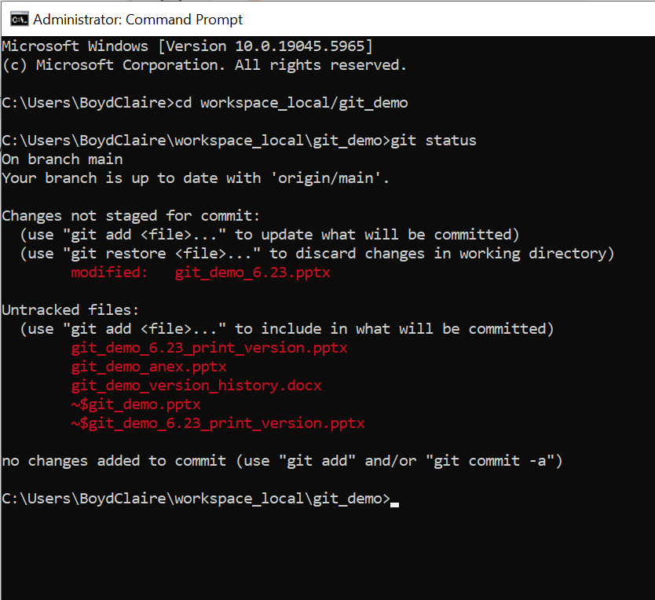
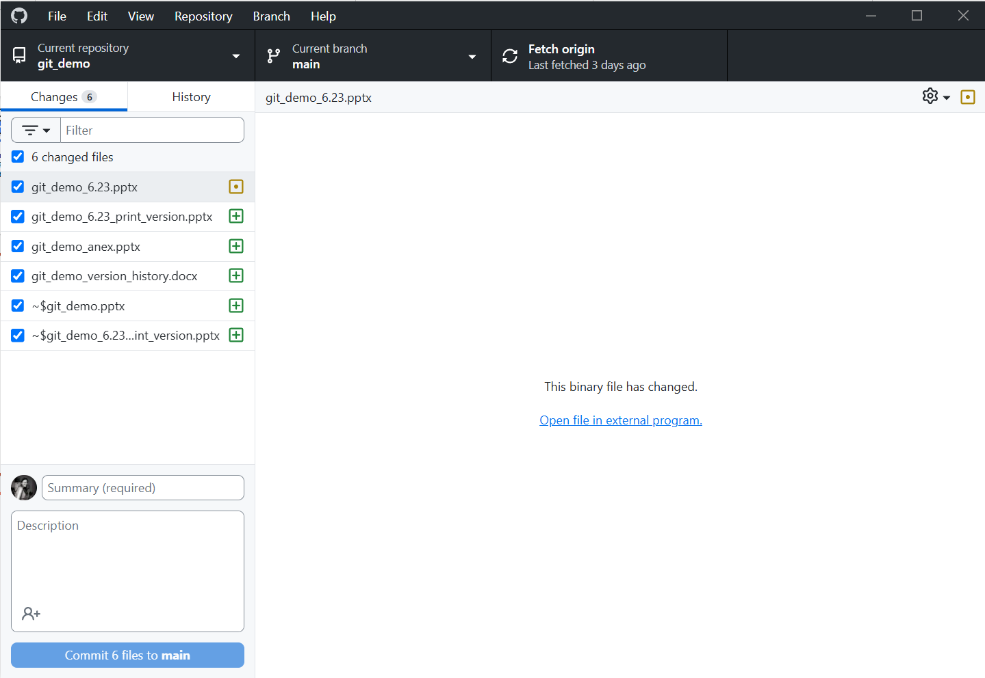
How can you use git?
Command line interface (CLI)
GitHub Desktop App
Notes:
Live demo if time allows

Slide 21
Demo

Slide 22
What can we use it for?

Slide 23
Existing use cases for GitHub
Benefits for data science teams:
Host internal/external documentation for onboarding materials
Create homes for all project related materials as the ground truth, where everyone can access/update them
Allow for easier code review and internal collaboration, to minimize reliance on institutional knowledge to repeat tasks
Create packages for internal use, to streamline data pipelines/repetitive tasks
Use git actions for additional compute power
Collaborate with other teams/organizations on projects
Benefits for other teams:
Build and host interactive maps and dashboards to display information in an intuitive way, completely free
Use it as a project management tool to track progress on team goals/work
Walk through:
https://github.com/orgs/nycdepartmentoffinance/repositories

Slide 24
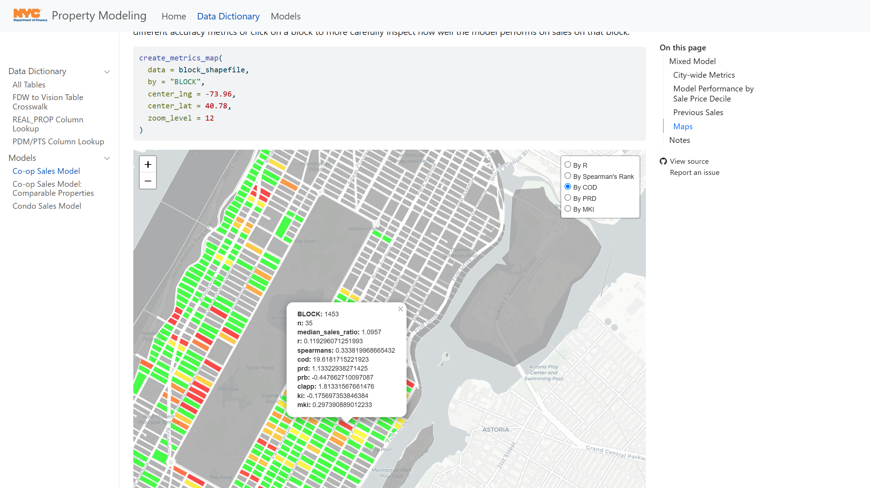
Existing use case #1: Free websites, hosting interactive maps
https://nycdepartmentoffinance.github.io/models/coop_sales_model.html#maps

Slide 25
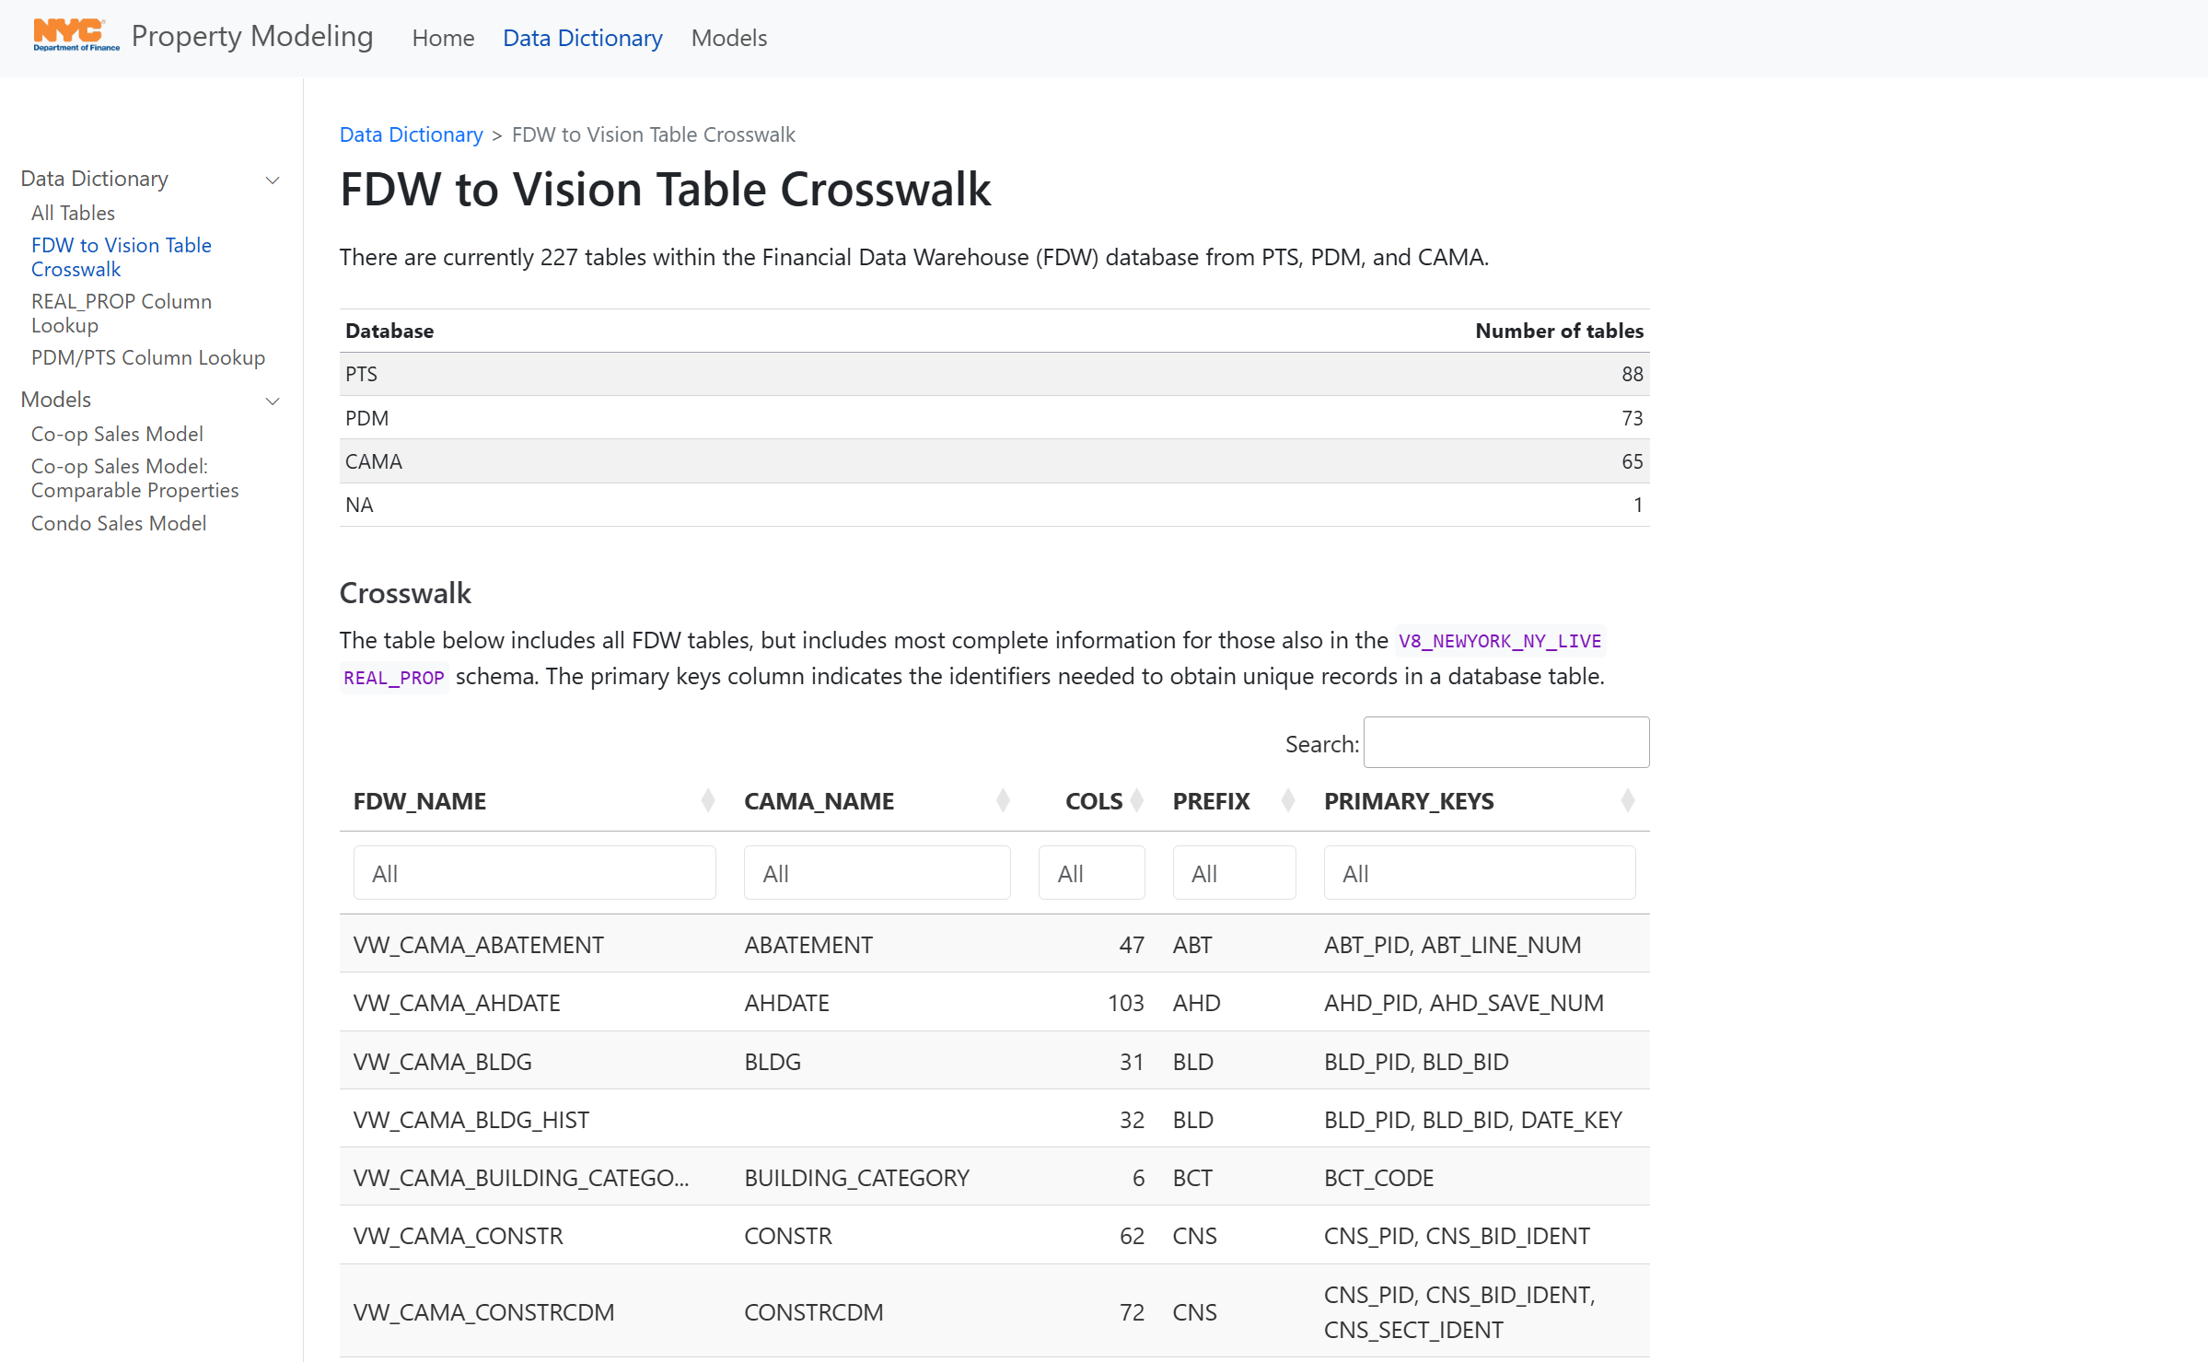
Existing use case #2: Interactive data dictionaries
https://nycdepartmentoffinance.github.io/data_dictionary/fdw_crosswalk.html

Slide 26
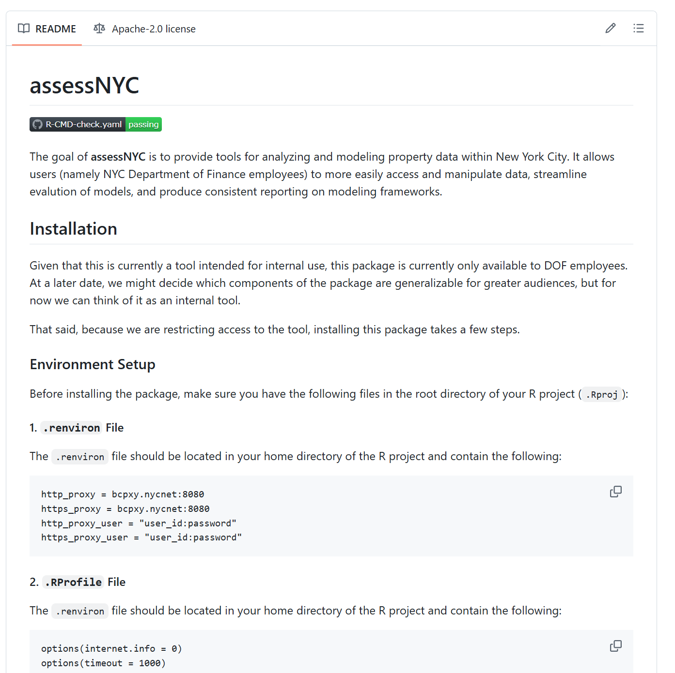
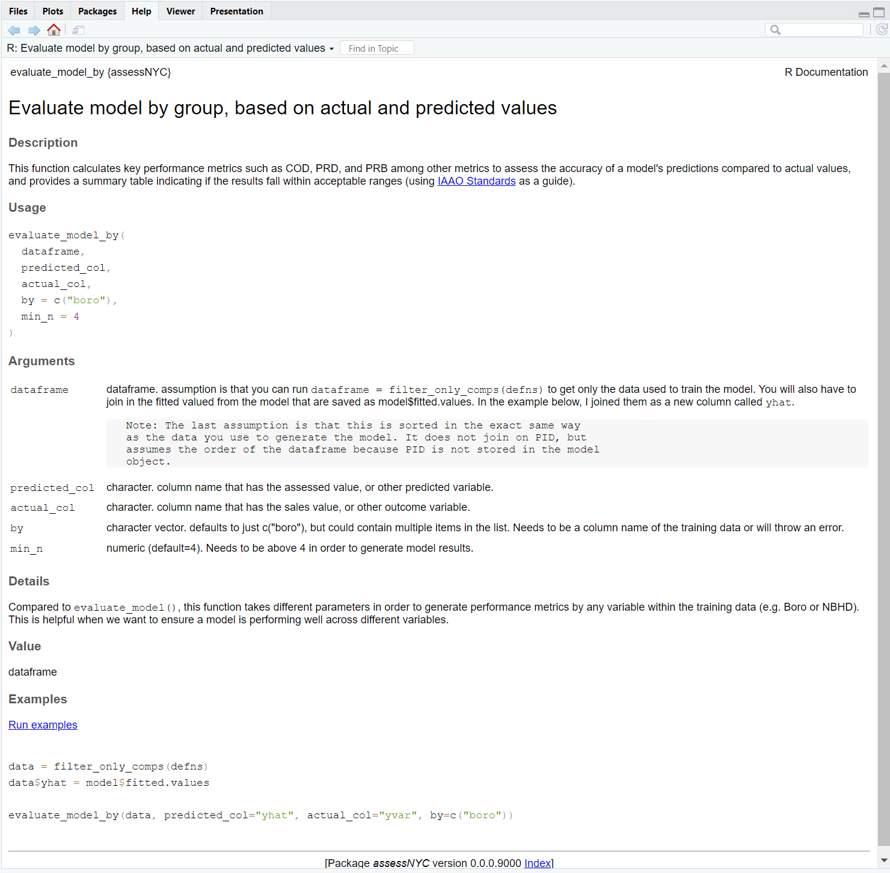
Existing use case #3: Internal packages for common tasks
assessNYC R package
evaluate_model_by() function within package
https://github.com/nycdepartmentoffinance/assessNYC

Slide 27
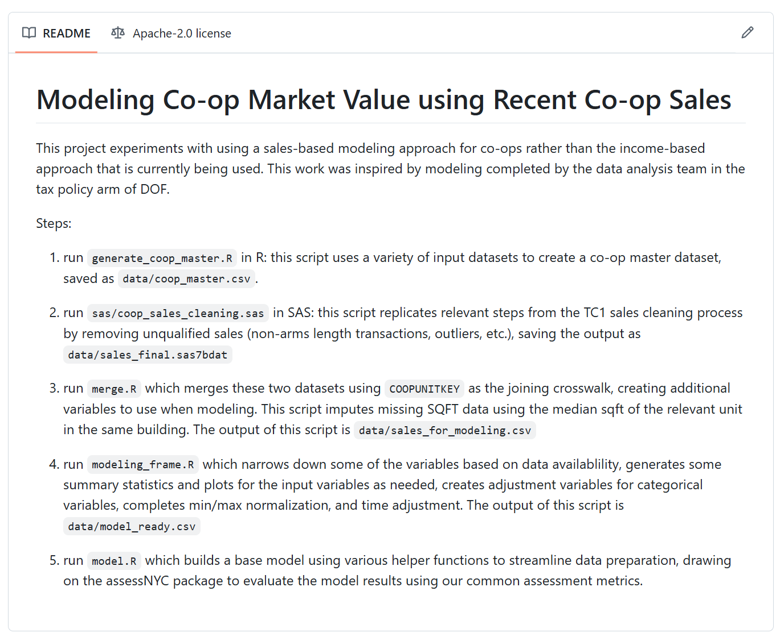
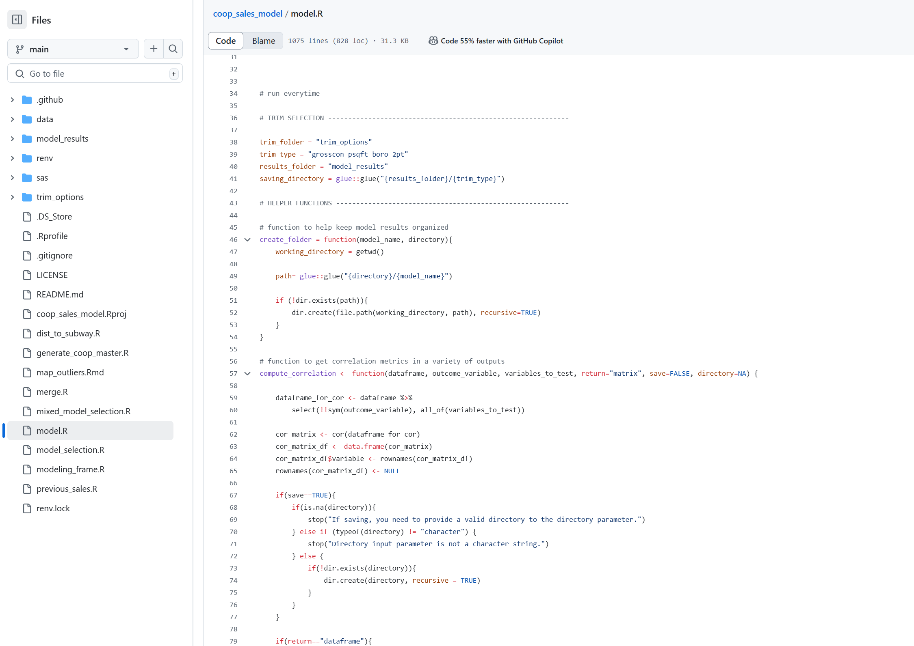
Existing use case #4: Documenting existing project work
Documentation
Code

Slide 28
Want to try it for yourself?

Slide 29
Opportunities to get started
Initial set-up
Download git
Create a free GitHub account
Download GitHub Desktop (if you prefer a point and click interface)
Explore the onboarding resources on our DOF GitHub organization:
Github set-up with proxy server
Proxy set-up for RStudio // VSCode
Database Connections in R // Python
Project set-up for R // Python using virtual environments (to track package uses/dependencies)
Create your own repository to start playing around with how it works.

Slide 30
Questions?

